Slide 1

Quiz application (using Appium Tool)
Kalluru nikhitha reddy
192011109
cse

Slide 2
Project includes :
ABSTRACT
OBJECTIVES & Introduction
PROPOSED WORK
NO OF TEST CASES
APPS AND TOOLS INSTALLATION
APPIUM SERVER
IMPLEMENTING TESTING
TEST CASE OUTCOMES
CONCLUSION

Slide 3

Abstract:
Quiz Application” is a collection of a different quizzes likes Technical , General Knowledge, English Grammar , Quantitative Aptitude.
User can access only one quiz at a time with a portable handheld device.
There will be a limited number of questions and for each correct answer user will be get a credit score.
To develop a user friendly application,our application will contain:
Next Question
Quit
View Previous History

Slide 4
Objectives :
The main goal of the application is to enable users to practice for subjective tests conducted for admissions and recruitment, with focus on some topics.
This quiz application includes three main modules, namely (i) Math, (ii) Geography, and (iii) Literature.
This quiz includes three functions: (i) Next Question, (ii) Quit, and (iii) View previous history, which are collectively named as life lines that help users to answer questions correctly.
These functions can be used only once by a user.
It stores the result in a backend SQL lite database and can be viewed as a user history in the future.

Slide 5
Introduction :
Our project is to facilitate students in learning, gaining, and Improving their knowledge skills.
The users can prepare for interviews, entrance tests, or any other corresponding purposes in a fresh mood and can’t get bored or frustrated due to the dullness of the app.
We designed the application to facilitate the users to be the ability to take short quizzes using portable devices such as smartphones and tablets.
The most attractive feature of our app is that we take learning and fun side by side.
The user can take short quizzes anywhere at anytime.

Slide 6
Proposed work :
We are starting with a simple app which some of you must recognize as it used to be the part of phones android made.
Quiz application is free and it delivers everything basic users expect from this kind of app.
In just a few steps you have the option to attend the quiz based on the category you select.
The application records the information even when the person quits from the quiz which enables the user to resume the quiz after some time.

Slide 7

No of test cases:
App Launch.
Performance.
User convenience.
Game starting.
Keyboard working.
Score appearance.
Quiz options.

Slide 8



Applications used:

Slide 9
APPS AND TOOLS (APPIUM & ANDROID STUDIO)
•Appium
1.Open source Automation tool.
2.It is also a Automation Framework.
3.Automates different types of mobile applications testing.
4.It can test web , Native and Hybrid application.
5.It supports multiple programming languages. (Java , python , ruby and many more )
6.It works on Emulator as well as Real Devices.
Android Studio
1.It is Integrated development Environment.
2.It has fast Emulator for App Testing.
3.Used to Develop applications for Android devices.
4.It is an open source software.

Slide 10
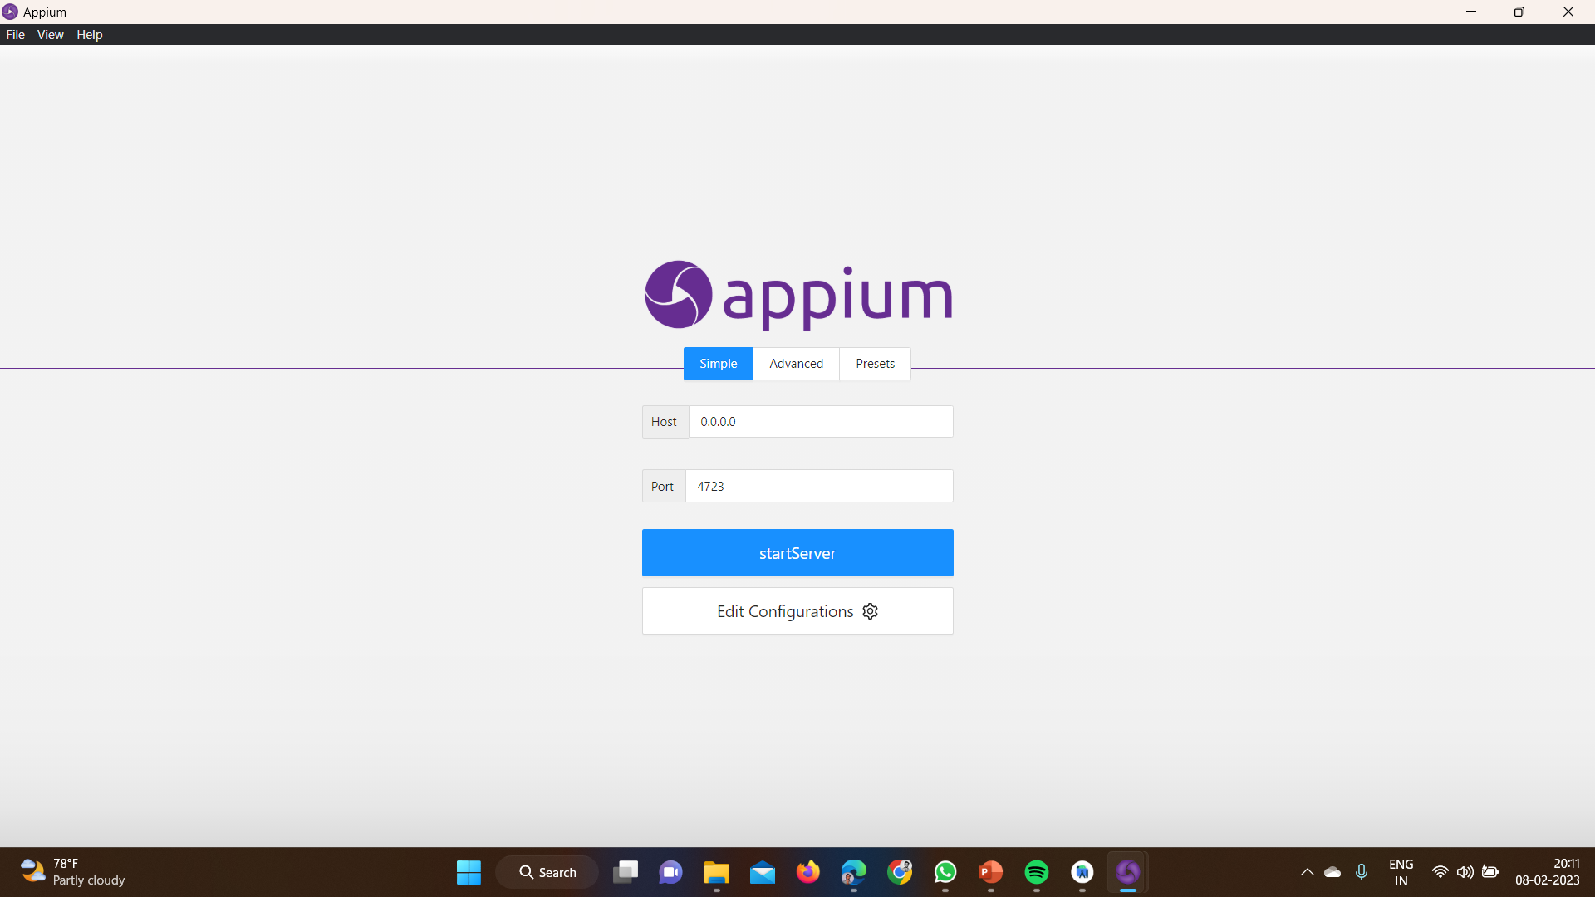
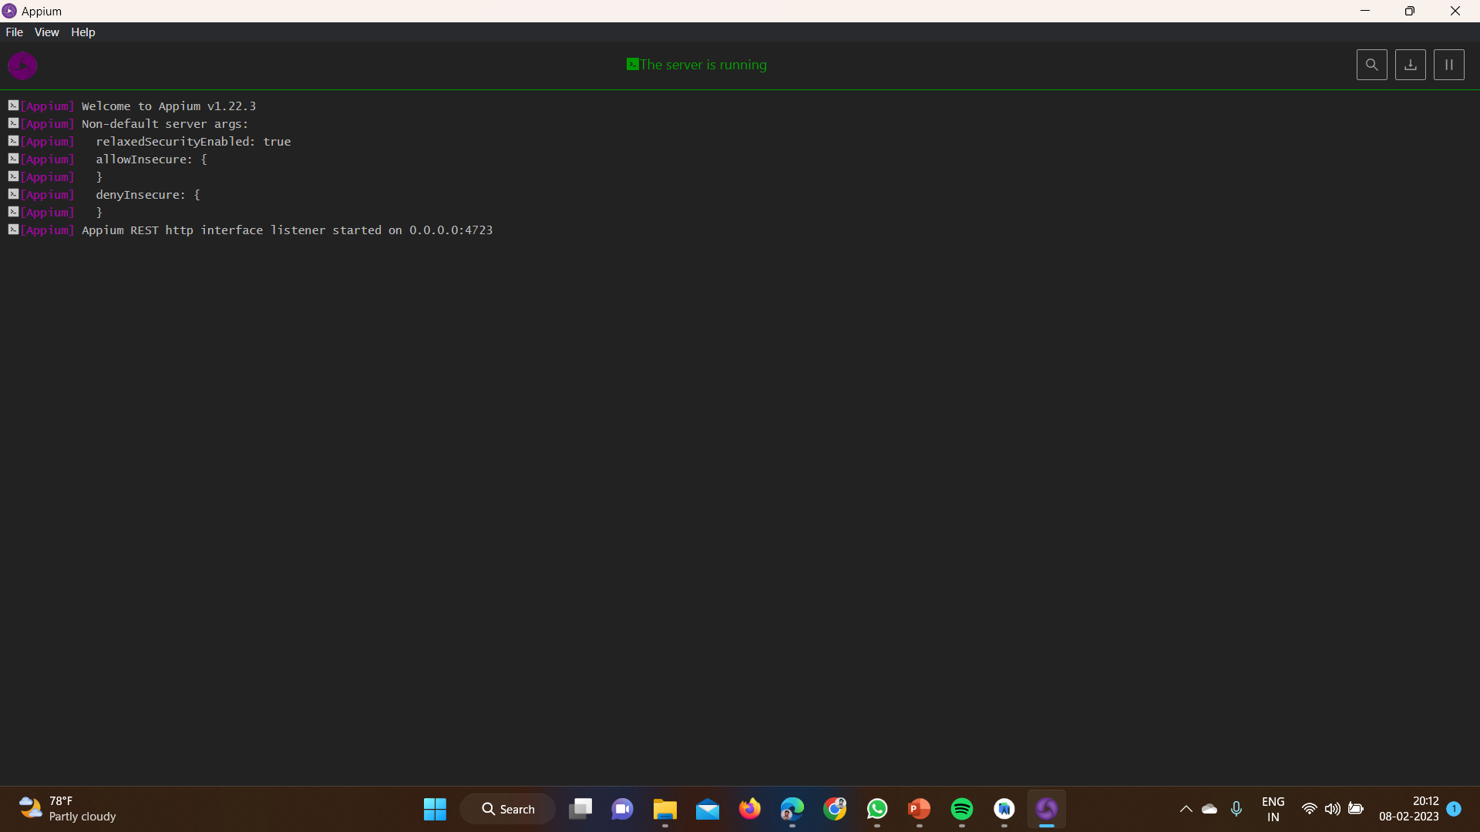
Appium Server:

Slide 11
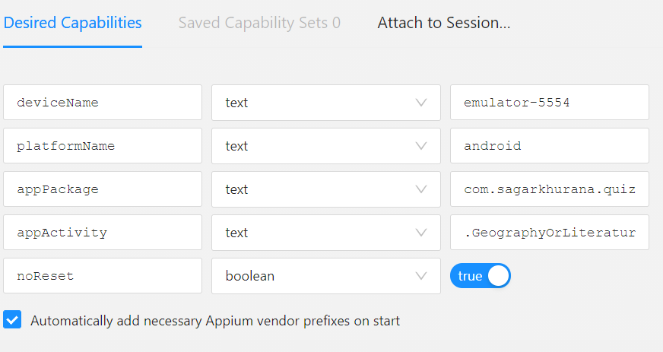
Appium Inspector (Desired Capabilities)
Give the desired capabilities in Appium inspector.
It will start the session and gives you java code to start the testing.
Paste the code in IntelliJ IDE, and start the testing.

Slide 12
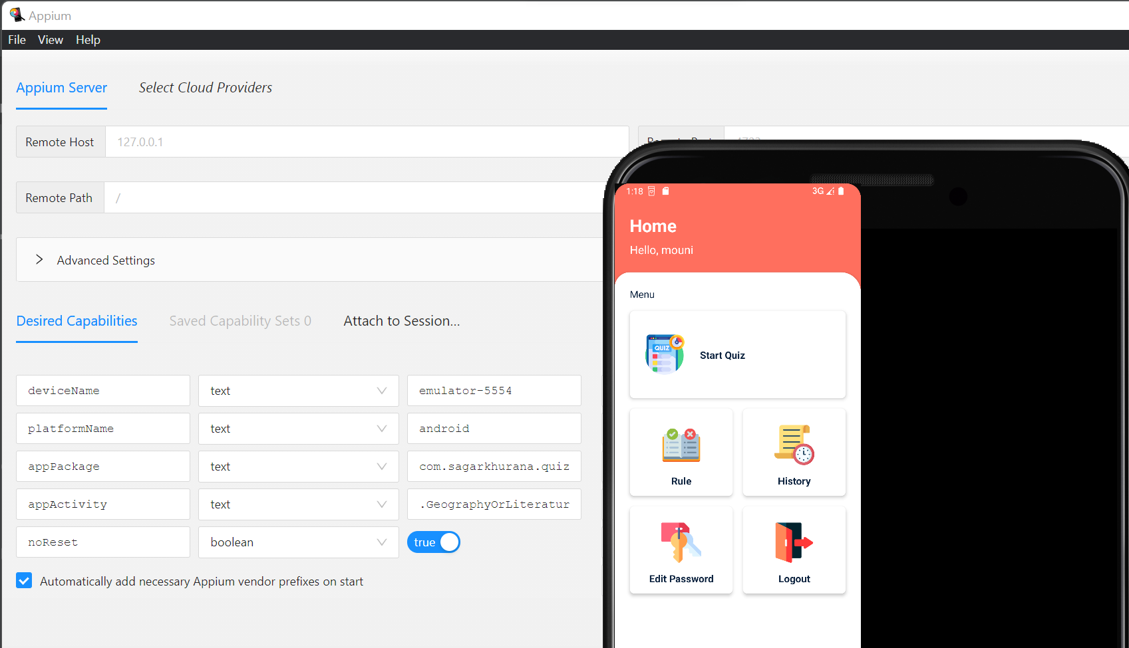
Implementation and testing:

Slide 13
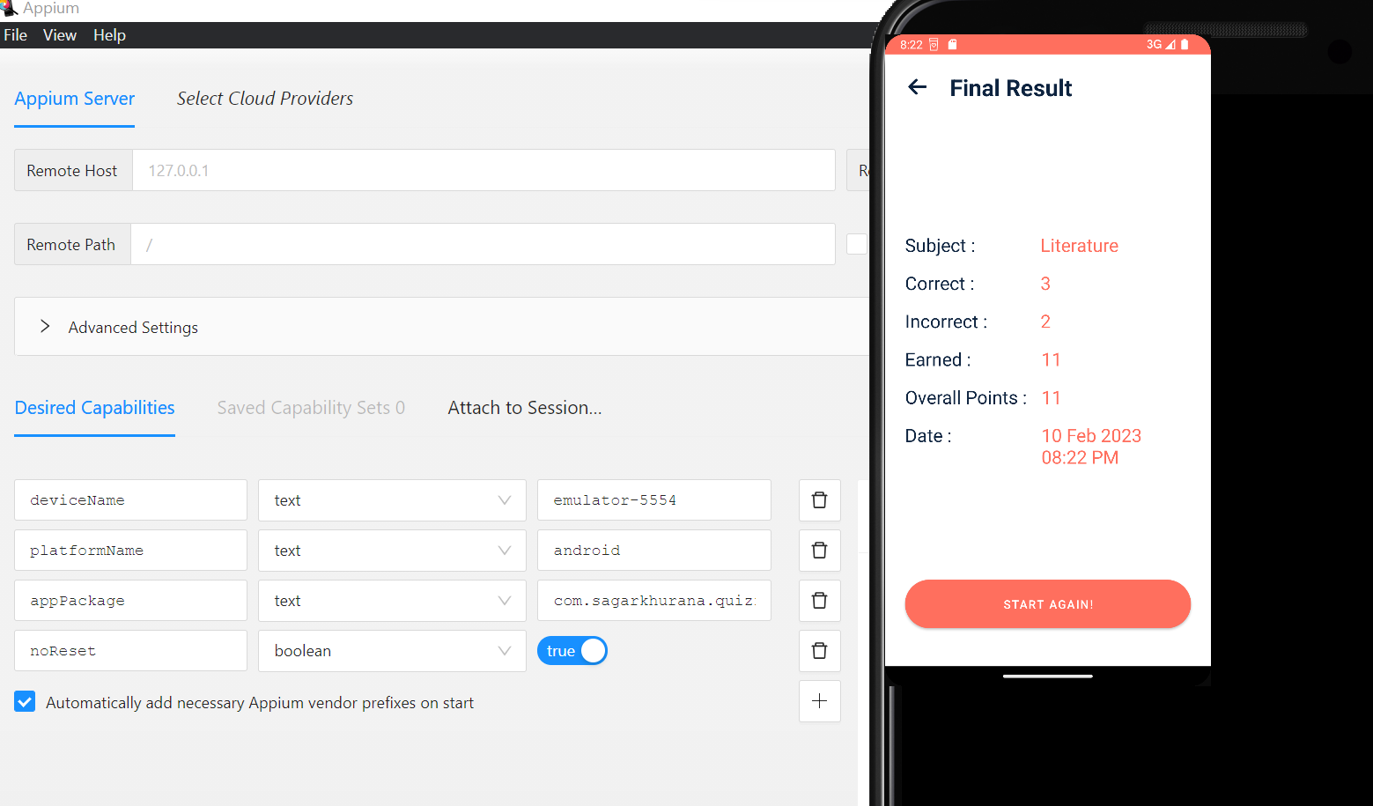
Implementation and testing:

Slide 14
Test case outcomes :
Verify the app launching | positive
Game performance | positive
User convenience | positive
Game starting | positive
Keyboard working | positive
Score appearance | positive
Quiz game options | positive

Slide 15

Conclusion :
From the test case outcomes we can say that this game is very efficient and useful.
Since, this quiz game got 100% positive response.
Testing process is done using both the verification and validation.

Slide 16
References:
https://www.tutorialspoint.com/android/android_online_quiz.htm
https://appsgeyser.com/blog/create-quiz-app-for-android/
https://www.geeksforgeeks.org/how-to-create-a-quiz-app-in-android/
https://projectworlds.in/android-projects-with-source-code/android-studio-quiz-app-source-code-free-download/

Slide 17


